Slide 1

Case Study: Disruption in the Latin American Payment Industry
By: Peter Repetto

Slide 2

Who is PagSeguro?
PagSeguro is a Brazilian electronic payments company
It was founded out of UOL group in 2006
In 2013 PagSeguro expanded from online payments to POS payments
In May 2019 PagSeguro announced it would launch PagBank
Source: http://investors.pagseguro.com/ir-home

Slide 3
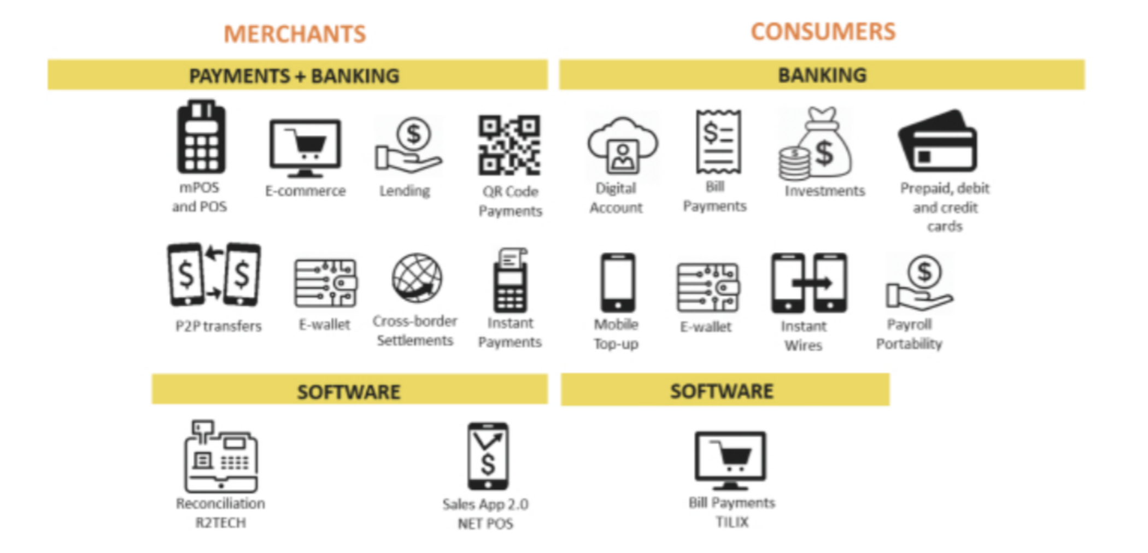
How does PagSeguro Work?
Source: http://investors.pagseguro.com/our-vision/Index?KeyGenPage=1073753120

Slide 4
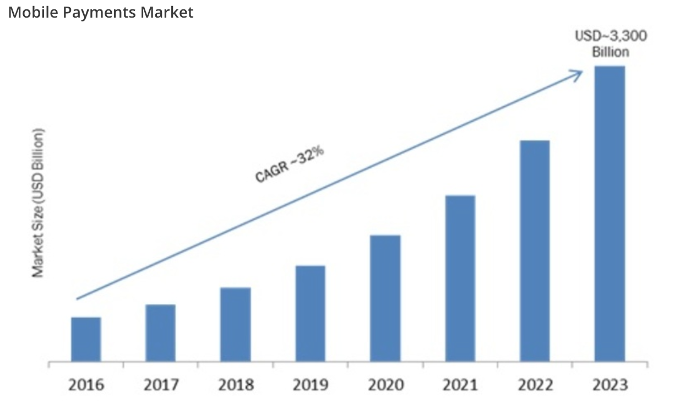
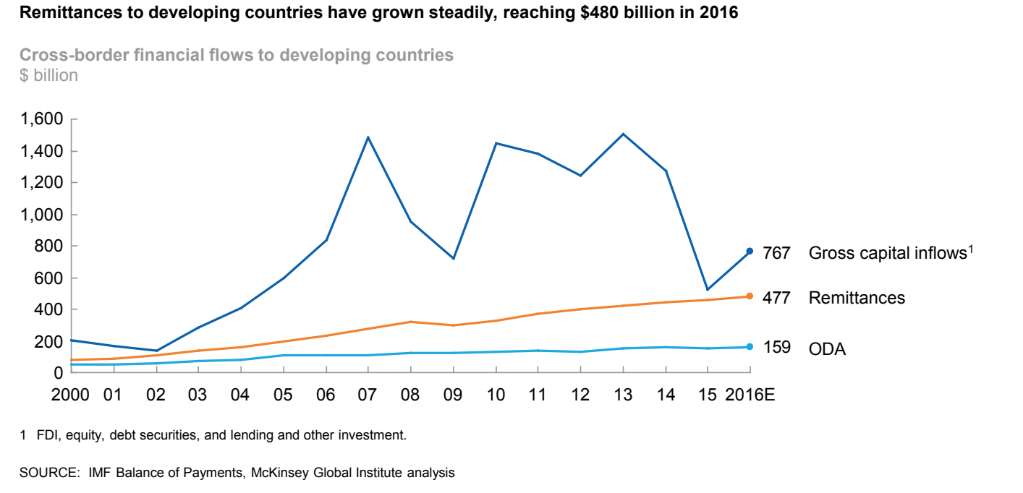
What trends are supportive for PagSeguro and global payments?
Source: https://www.marketresearchfuture.com/reports/mobile-payments-market, -2922https://www.mckinsey.com/~/media/McKinsey/Industries/Financial%20Services/Our%20Insights/The%20new%20dynamics%20of%20financial%20globalization/Financial%20globalization_Full%20Report_August_29_2017%20(1).ash

